Slide 1
IMPORTANCE OF SLEEP
PREPARED BY :–
Name- Ashutosh Dash
Branch- Computer Science and Engineering
Section- 2041023
Registration Number- 2041004104

Slide 2
INTRODUCTION
Sleep is an essential function that allows your body and mind to recharge, leaving you refreshed and alert when you wake up.
Sleep is a golden chain that ties our mind and body together.
The sleep drive – also known as sleep-wake homeostasis may be linked to adenosine, an organic compound produced in the brain.

Slide 3
WHY DO WE SLEEP?
Sleep keeps us healthy and functioning well.
It lets our brain and body repair.
An internal body clock regulates our sleep cycle, controlling when we feel tired and ready for bed or refreshed and alert.

Slide 4
BENEFITS OF SLEEP
Sleep is like a dishwasher for our brain.
Cellular restoration.
Consolidation and retrieval of thoughts.
Proper sleep helps us maintaining a healthy weight.

Slide 5
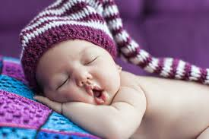
WHAT INFLUENCES SLEEP?
Melatonin
Light also circadian rhythm.
The hypothalamus, a peanut-sized structure deep inside the brain, contains groups of nerve cells that act as control centers affecting sleep and arousal.

Slide 6
STAGES OF SLEEP
Stage 1 NREM: This first stage marks the transition between wakefulness and sleep.
Stage 2 NREM: This second NREM sleep stage is characterized by deeper sleep.
Stage 3 NREM: This stage plays an important role in making us feel refreshed and alert the next day.
REM: The first REM stage will occur about 90 minutes after you fall asleep and occurs after every cycle of the stages.

Slide 7
SLEEP AMOUNT
AGE GROUP | AGE RANGE | RECOMMENDED SLEEP HOURS
Newborn | 0-3 months | 14-17 hours
Infant | 4-11 months | 12-15 hours
Toddler | 1-2 years | 11-14 hours
Pre-School | 3-5 years | 10-13 hours
School age | 6-13 years | 9-11 hours
Teen | 14-17 years | 8-10 hours
Adult | 18-64 years | 7-9 hours
Senior citizens | 65 years or older | 7-8 hours

Slide 8

HARMFUL EFFECTS OF SLEEPLESSNESS
Memory problems
Difficulty in concentration
Problems in collecting previous information.
Unable to communicate properly.

Slide 9
GETTING PROPER SLEEP
Establishing a realistic bedtime and sticking to it
Physical activities
Having a well balanced diet
Screen ban in the bedroom

Slide 10
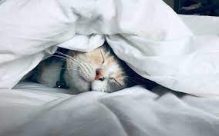
THANK YOU

